Slide 1
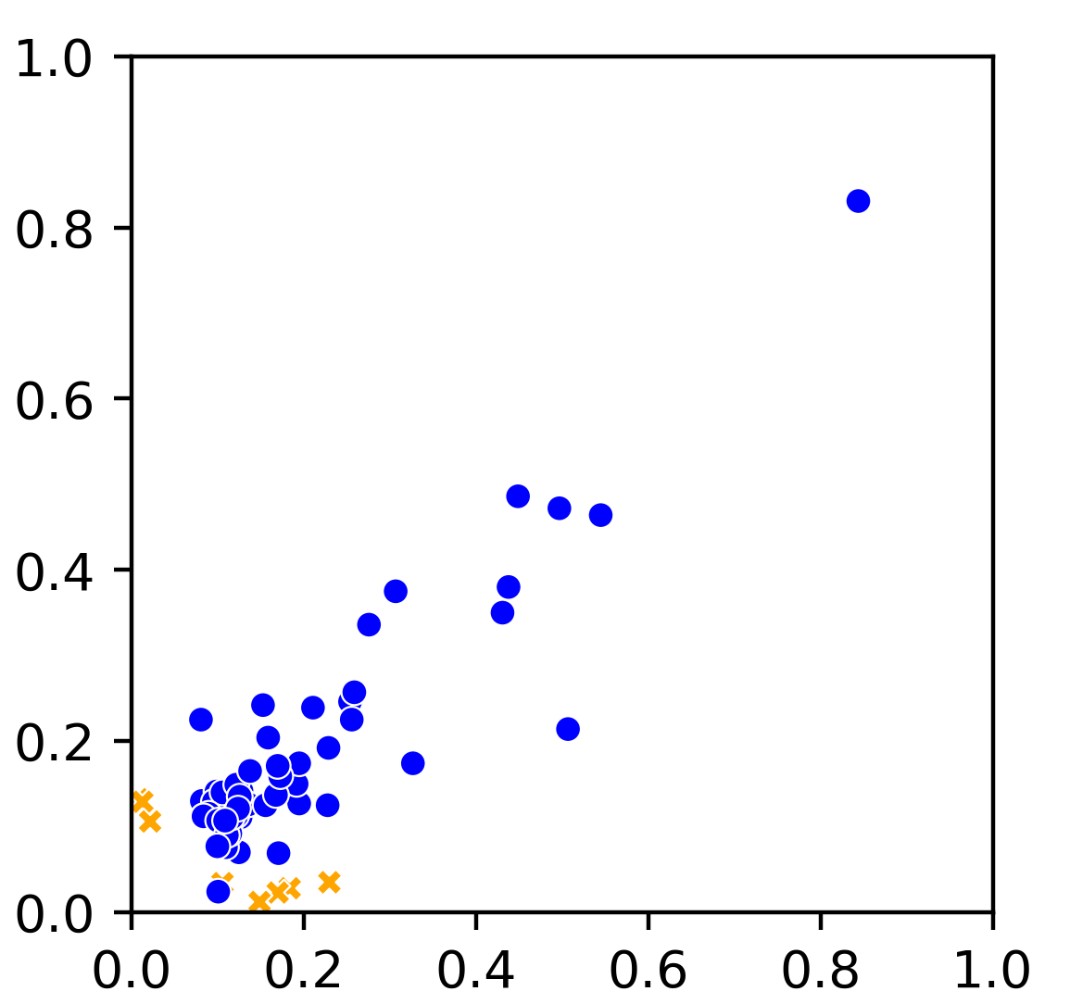
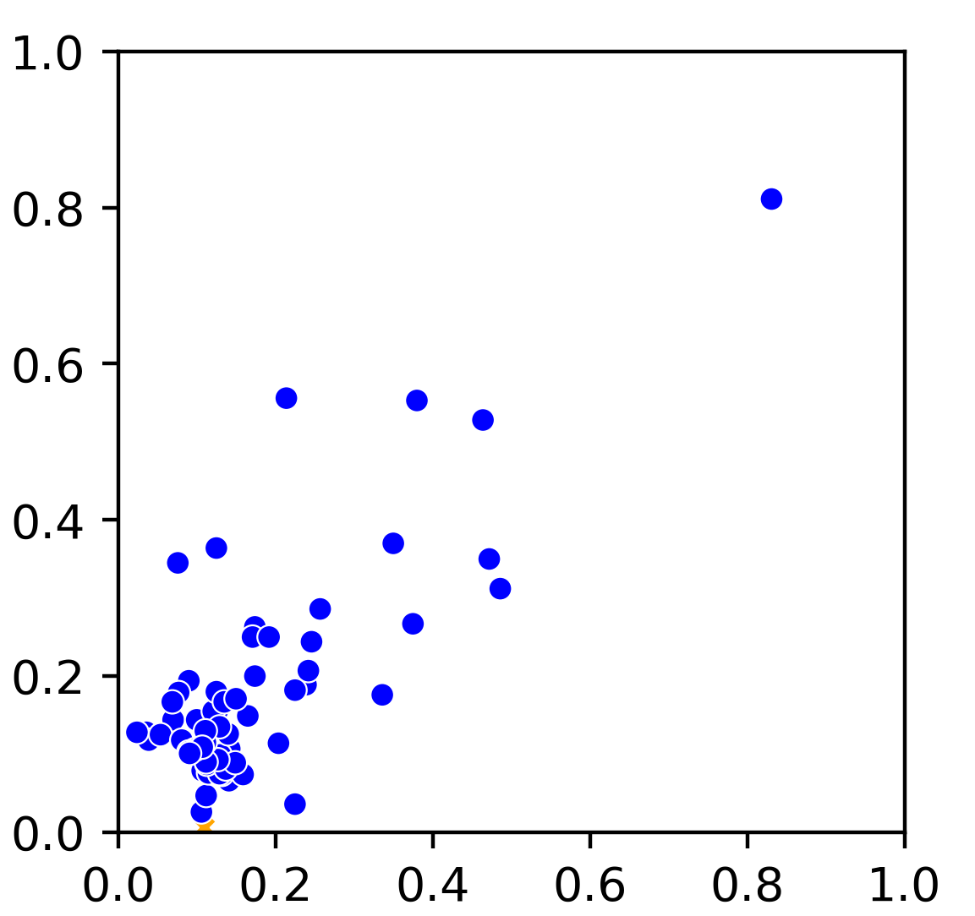
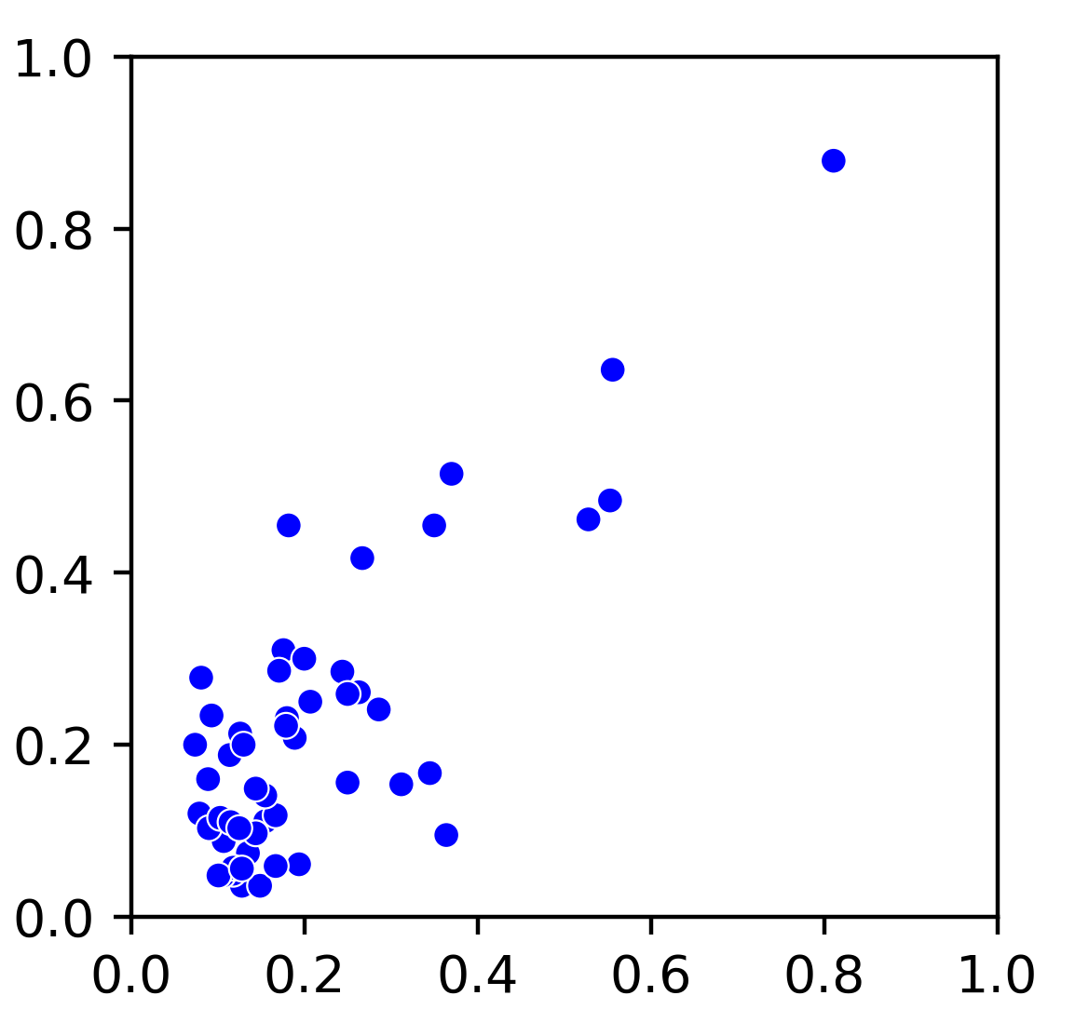
A
MT-B
MT-C
MT-A
6
55
MT-D
3
22
69
15
0
1
68
3
0
6
6
1
B
R = 0.81
R = 0.76
R = 0.79
MT-B
MT-C
MT-D
MT-A
MT-B
MT-C
Supplementary Figure 11. (A) Overlap of m5C sites present in mitochondrial libraries. (B) Correlation of methylation level in sites present in at least one condition. Differentially methylated sites are indicated by an orange “X” (Fisher Exact test, Benjamini-Hochberg adjusted p-value < 0.01).

